Slide 1

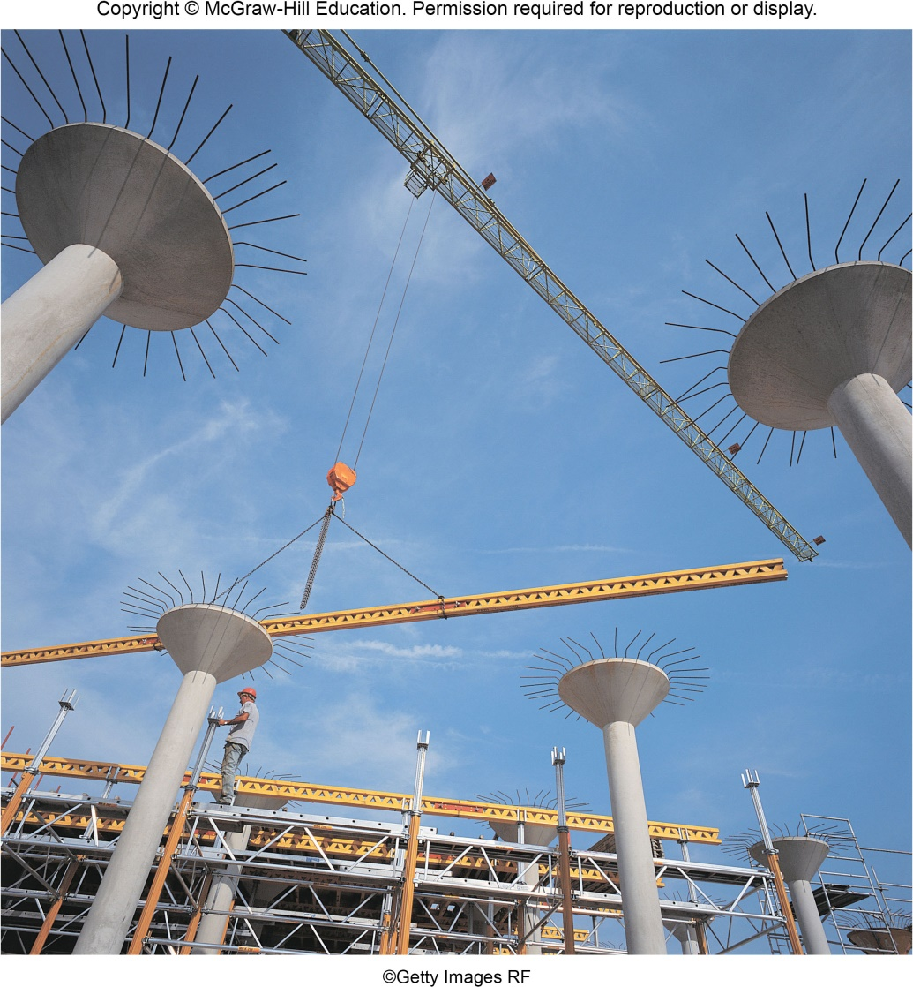
VECTOR MECHANICS FOR ENGINEERS By: Fardinand P. Beer; E. Russell Johnston, Jr.; David F. Mazurek
ENGINEERING 3120
STATICS
CHAPTER 2
STATICS OF PARTICLES
Slides revised by:
A.A. KHANDKER, Ph.D., P.E.
Copyright: McGraw Hill Education

Slide 2
STATICS OF PARTICLES - TOPICS IN CHAPTER 2
Application
Introduction
Forces on a Particle: Resultant of Two Forces
Vectors
Addition of Vectors
Resultant of Several Concurrent Forces
Sample Problem 2.1
Sample Problem 2.2
Rectangular Components of a Force: Unit Vectors
Addition of Forces by Summing X and Y Components
Sample Problem 2.3
Equilibrium of a Particle
Free-Body Diagrams and Problem Solving
Sample Problem 2.4
Sample Problem 2.6
Expressing a Vector in 3-D Space
Sample Problem 2.7

Slide 3

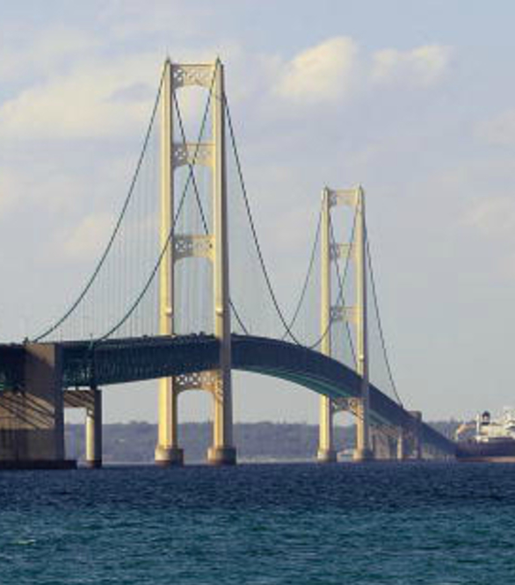
STATICS OF PARTICLES - APPLICATION
The tension in the cables supporting this girl and the bridge can be found using the concepts in Statics

Slide 4
STATICS OF PARTICLES - INTRODUCTION
The objective for the current chapter is to investigate the effects of forces on particles: -
- replacing multiple forces acting on a particle with a single equivalent or resultant force,
- relations between forces acting on a particle that is in a state of equilibrium.
The focus on particles does not imply a restriction to miniscule bodies. Rather, the study is restricted to analyses in which the size and shape of the bodies is not significant so that all forces may be assumed to be applied at a single point.

Slide 5
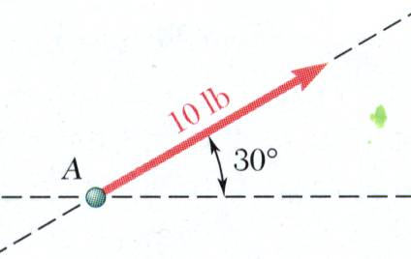
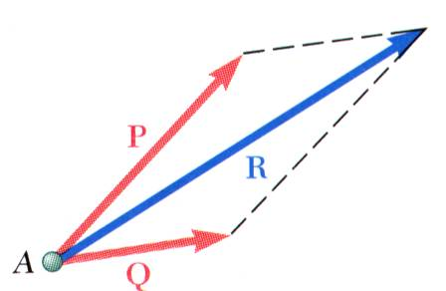
RESULTANT OF TWO FORCES
Force: action of one body on another; characterized by it’s
point of application,
b) magnitude,
c) line of action, and
d) sense.
Experimental evidence shows that the combined effect of two forces may be represented by a single resultant force.
The resultant is equivalent to the diagonal of a parallelogram which contains the two forces in adjacent legs.
Force is a vector quantity.

Slide 6
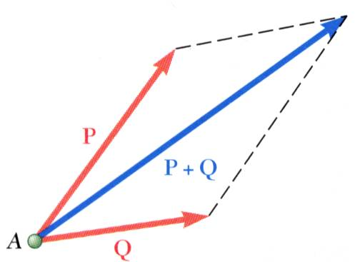
VECTOR AND SCALAR PARAMETERS
Vector: Mathematical expressions or parameters possessing magnitude and direction which add according to the parallelogram law.
Examples: force, displacement, velocity, acceleration.
Vectors can be expressed as P, P, or P .
An arrow represents the direction of a Vector and the length of the arrow represents the magnitude P in italics.
Scalar: Physical quantities which have magnitude but not direction, such as volume V, mass M or energy E.

Slide 7
VECTOR CLASSIFICATION
Fixed or bound vectors have well defined points of application that cannot be changed without affecting an analysis. Such as a Force acting on a particle at a given point in a given direction.
Free vectors, such as couples, may be freely moved in space without changing their effect on an analysis.
Sliding vectors may be applied on a rigid body anywhere along their line of action without affecting an analysis

Slide 8
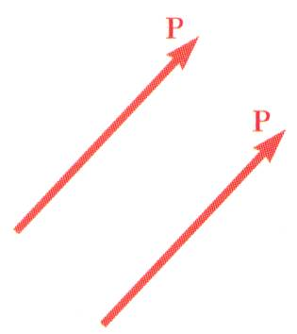
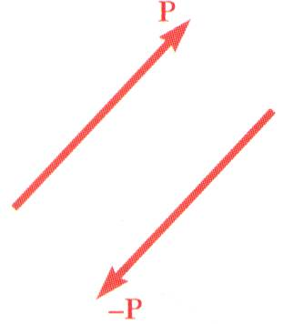
VECTOR CLASSIFICATION
Equal vectors have the same magnitude and direction,
but not the same point of application. Equal vectors may be represented by same letter
Negative vector of a given vector P has the same magnitude and the opposite direction -P
We can write P + (-P) = 0

Slide 9
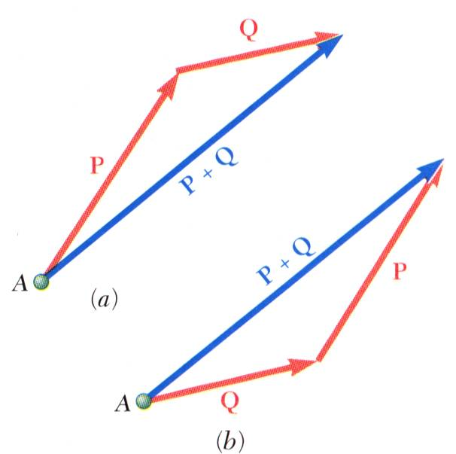
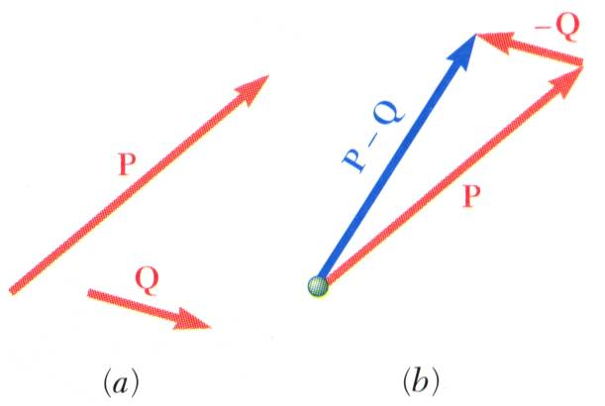
ADDITION OF TWO VECTORS
Parallelogram Law for vector addition is established experimentally but cannot be derived or proved mathematically
Triangle rule for vector addition can be derived from the parallelogram law.
Vector addition is commutative,
P + Q = Q + P
Vector subtraction is equivalent to the addition of the corresponding negative vector
P - Q = P + (-Q)

Slide 10
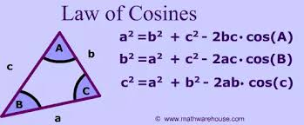
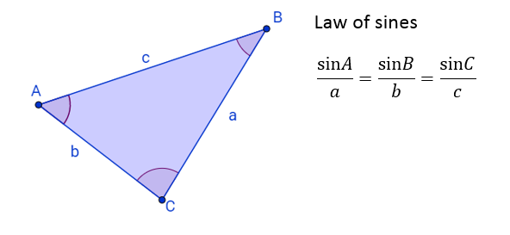
TRIGONOMETRY - LAW OF SINES AND LAW OF COSINES

Slide 11
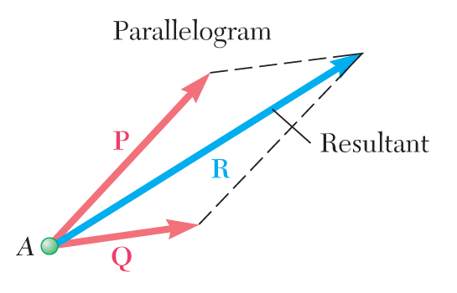
LAW OF SINES AND LAW OF COSINES
B
Q
C
P
R
A
Using Law of Cosines: R² = P² + Q² -2P.Q cosB
Using Law of Sines:: sinA/Q = sinB/R = sinC/P

Slide 12
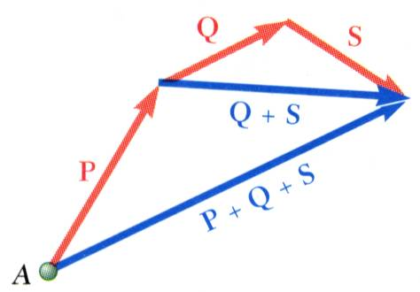
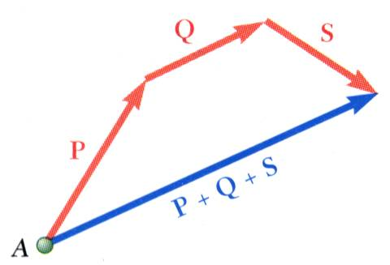
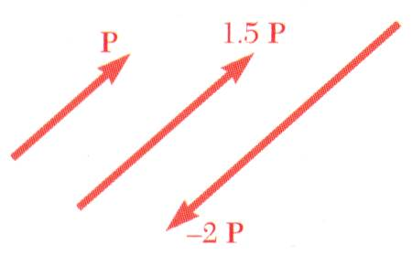
ADDITION OF MULTIPLE VECTORS
Addition of three or more vectors through repeated application of the triangle rule
Vector addition is associative
The polygon rule for the addition of three or more vectors.
Multiplication of a vector by a scalar

Slide 13
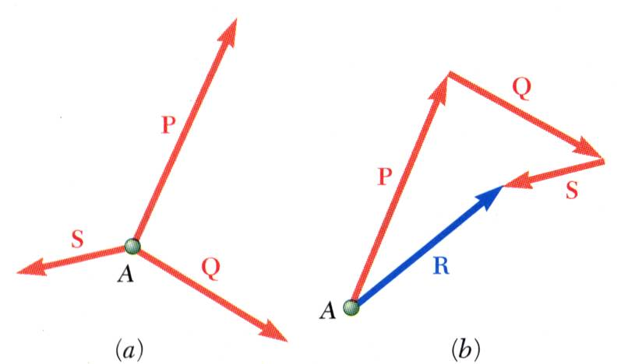
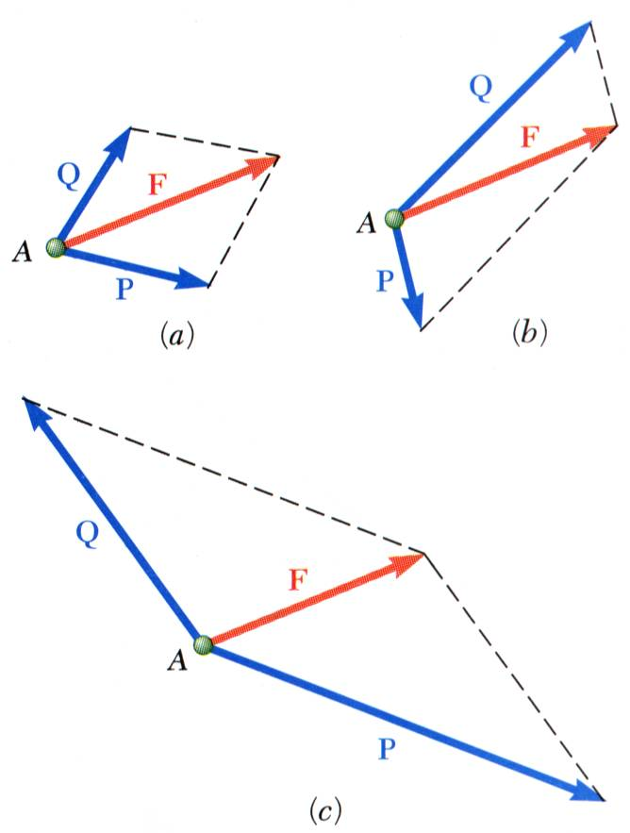
RESULTANT OF SEVERAL CONCURRENT FORCES
Concurrent forces: set of forces which all pass through the same point. A set of concurrent forces applied to a particle may be replaced by a single resultant force which is the vector sum of the applied forces.
.
Vector force components: Two or more force vectors which, together, have the same effect as a single force vector.

Slide 14
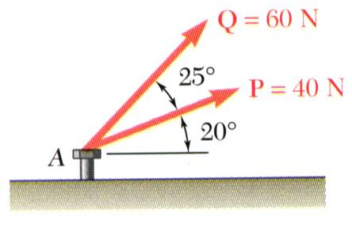
EXAMPLE PROBLEM 2.1
STRATEGY:
Graphical solution
- Construct a parallelogram with sides in the same direction as P and Q and lengths in proportion. Graphically evaluate the resultant which is equivalent in direction and proportional in magnitude to the diagonal.
The two forces P & Q act on a bolt at A.
Determine their resultant.
Trigonometric solution
- Use the triangle rule for vector addition in conjunction with the law of cosines and law of sines to find the resultant.

Slide 15
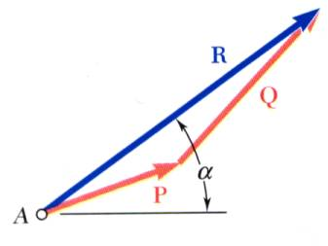
EXAMPLE PROBLEM 2.1 - SOLUTION
MODELING and ANALYSIS
Graphical solution (Triangle): A triangle is drawn with P and Q head-to-tail and to scale. The magnitude and direction of the resultant or of the third side of the triangle are measured,
The two forces P & Q act on a bolt at A.
Determine their resultant.

Slide 16
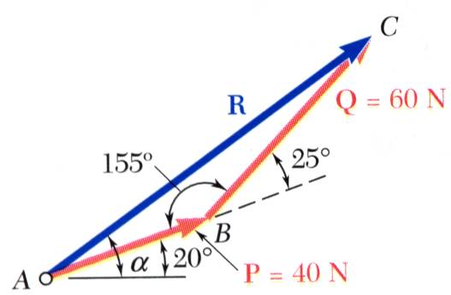
EXAMPLE PROBLEM 2.1 SOLUTION (Continued)
Trigonometric solution - Apply the triangle rule.
From the Law of Cosines,
From the Law of Sines,
REFLECT and THINK:
An analytical solution using trigonometry provides for greater accuracy. However, it is helpful to use a graphical solution as a check.

Slide 17
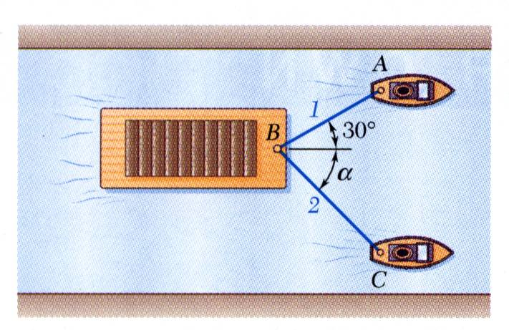
EXAMPLE PROBLEM 2.2
A barge is pulled by two tugboats A & C, using ropes 1 and 2 connected at a point B on the barge. Rope 1 is making 30º angle with the axis of the barge.
If the resultant of the forces exerted by the tugboats is 5000 lbf directed along the axis of the barge.
Determine: a) the tension in each of the ropes for α = 45º, b) the value of α for which the tension in rope 2 is minimum.

Slide 18
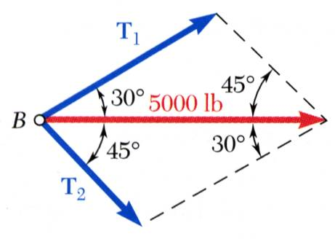
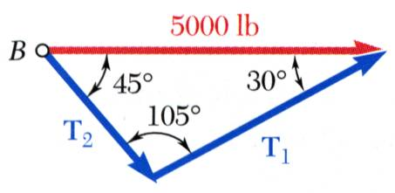
EXAMPLE PROBLEM 2.2 - Solution
A barge is pulled by two tugboats. If the resultant of the forces exerted by the tugboats is 5000 lbf directed along the axis of the barge, determine a) the tension in each of the ropes for α = 45º, b) the value of α for which the tension in rope 2 is a minimum.
Graphical solution - Parallelogram Rule with known resultant direction and magnitude, known directions for sides.
Trigonometric solution - Triangle Rule with Law of Sines

Slide 19
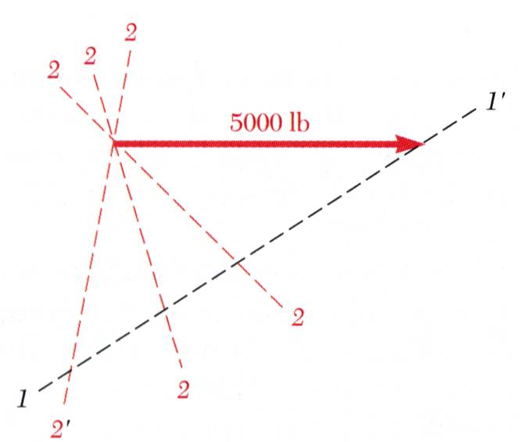
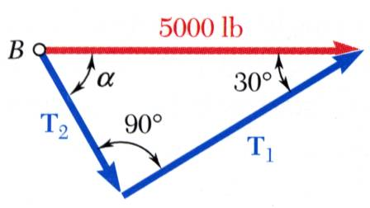
EXAMPLE PROBLEM 2.2 SOLUTION (Continued)
A barge is pulled by two tugboats. If the resultant of the forces exerted by the tugboats is 5000 lbf directed along the axis of the barge, determine a) the tension in each of the ropes for α = 45º, b) the value of α for which the tension in rope 2 is a minimum.
The angle for minimum tension in rope 2 is determined by applying the Triangle Rule and observing the effect of variations in α.
The minimum tension in rope 2 occurs when T₁ and T₂ are perpendicular.

Slide 20
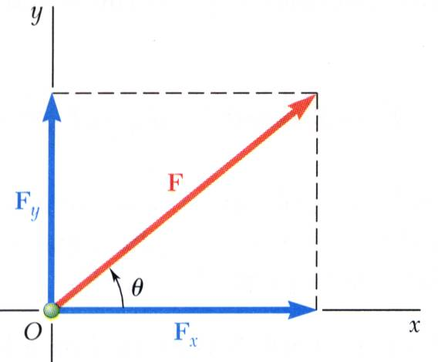
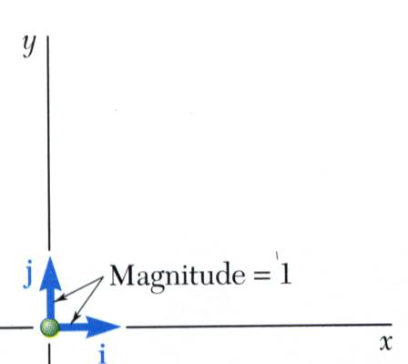
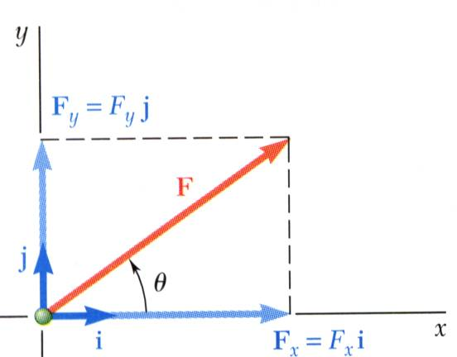
RECTANGULAR COMPONENTS OF A FORCE – UNIT VECTORS
A force vector may be resolved into two perpendicular components so that the resulting parallelogram is a rectangle. are rectangular vector components
Where,
Perpendicular unit vectors are parallel to the x and y axes.
Vector components may be expressed as products of the unit vectors with the scalar magnitudes of the vector components.
F_{x} and F_{y} are referred to as the scalar components of

Slide 21
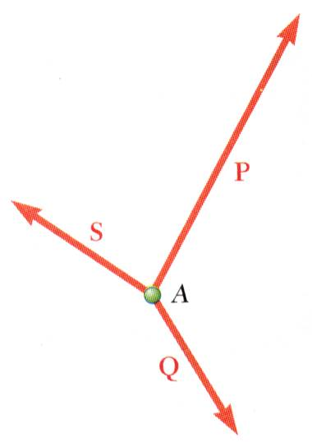
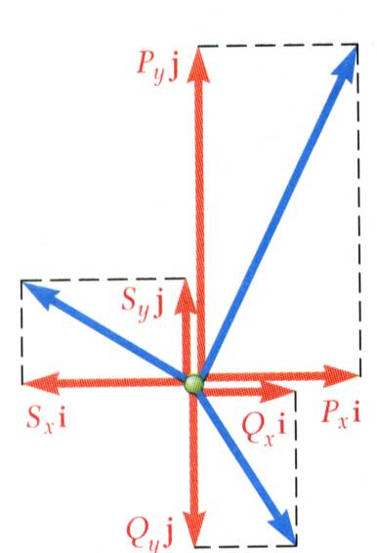
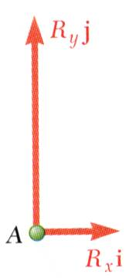
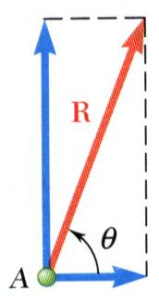
ADDITION OF FORCES BY SUMMING COMPONENTS
To find the resultant R of 3 or more concurrent forces P, Q & S, acting through the same point A
Resolve each force into rectangular components
The scalar components of the resultant
are equal to the sum of the corresponding scalar components of the given forces.
To find the resultant magnitude and direction:

Slide 22
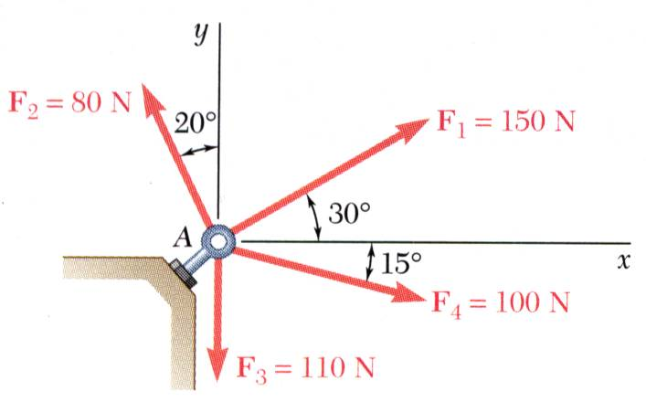
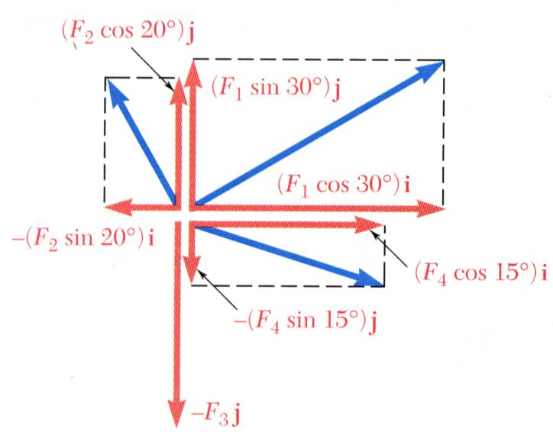
EXAMPLE PROBLEM 2.3
Four forces act on bolt A as shown. Determine the resultant of the forces on the bolt.
STRATEGY Resolve each force into rectangular components
(Use a table to simplify the computation of the components)
Determine the components of the resultant by adding the corresponding force components.

Slide 23
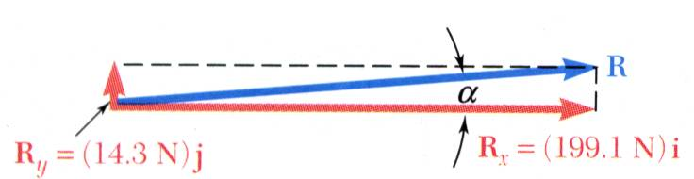
EXAMPLE PROBLEM 2.3 SOLUTION
Resolve each force into rectangular components
Calculate the magnitude and direction.
Magnitude of Resultant:
Direction of Resultant:

Slide 24
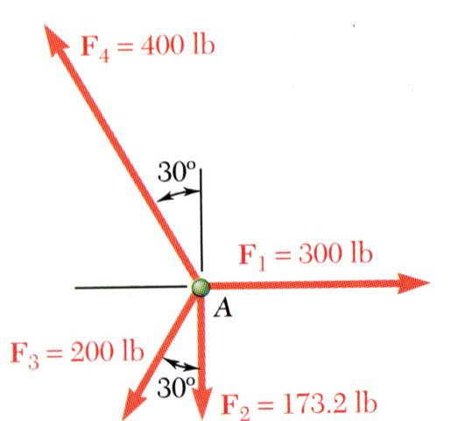
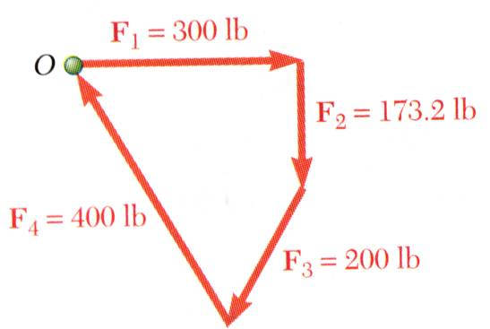
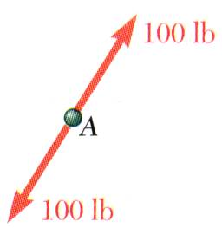
EQUILIBRIUM OF A PARTICLE
When the resultant of all forces acting on a particle is zero, the particle is in equilibrium.
Newton’s First Law: If the resultant force on a particle is zero, the particle will remain at rest or will continue at constant speed in a straight line.
Particle acted upon by three or more forces:
graphical solution yields a closed polygon
algebraic solution
Particle acted upon by two forces:
equal magnitude
same line of action
opposite sense

Slide 25
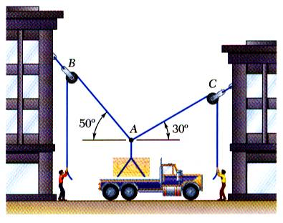
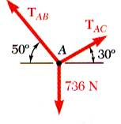
FREE-BODY DIAGRAMS
Space Diagram: A sketch showing the physical conditions of the problem.
Free-Body Diagram: A sketch showing only the forces on the selected particle.

Slide 26
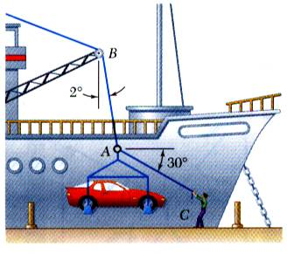
EXAMPLE PROBLEM 2.4
In a ship-unloading operation, a 3500-lb automobile is supported by a cable. A rope is tied to the cable and pulled to center the automobile over its intended position. What is the tension in the rope?
STEPS FOR SOLUTION
Step 1 - Construct a free-body diagram for the particle at the junction of the rope and cable.
Step 2 - Apply the conditions for equilibrium by creating a closed polygon from the forces applied to the particle.
Step 3 - Apply trigonometric relations to determine the unknown force magnitudes.

Slide 27
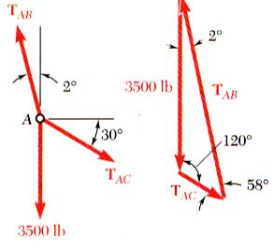
EXAMPLE PROBLEM 2.4 - SOLUTION
- Construct a free-body diagram for the particle at A.
- Apply the conditions for equilibrium.
- Solve for the unknown force magnitudes.

Slide 28
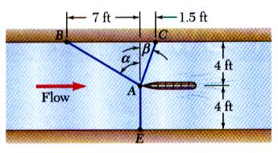
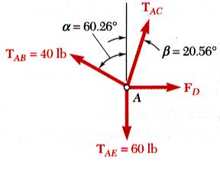
EXAMPLE PROBLEM 2.6 - SOLUTION
Choosing the hull as the free body, draw a free-body diagram.
It is desired to determine the drag force at a given speed on a prototype sailboat hull. A model is placed in a test channel and three cables are used to align its bow on the channel centerline. For a given speed, the tension is 40 lb in cable AB and 60 lb in cable AE. Determine the drag force exerted on the hull and the tension in cable AC.

Slide 29
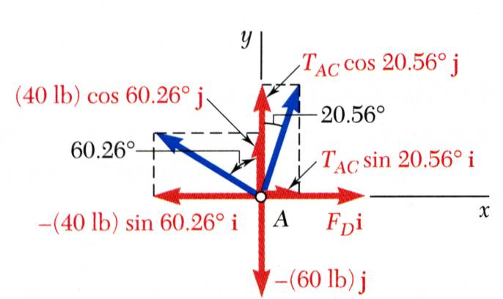
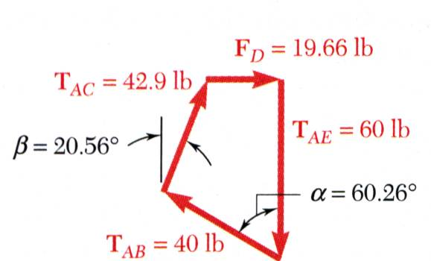
EXAMPLE PROBLEM 2.6 – SOLUTION (Continued)
Express the condition for equilibrium for the hull by writing that the sum of all forces must be zero.
Resolve the vector equilibrium equation into two component equations. Solve for the two unknown cable tensions.

Slide 30
EXAMPLE PROBLEM 2.6 (Continued)
This equation is satisfied only if each component of the resultant is equal to zero

Slide 31
Method of Problem Solution
Solution Check: - Test for errors in reasoning by verifying that the units of the computed results are correct,
- test for errors in computation by substituting given data and computed results into previously unused equations based on the six principles,
- always apply experience and physical intuition to assess whether results seem “reasonable”.

Slide 32
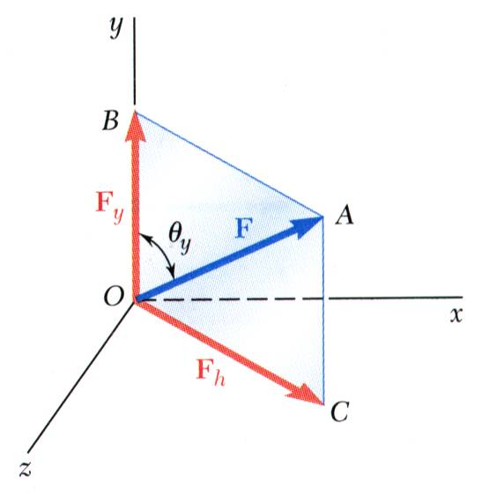
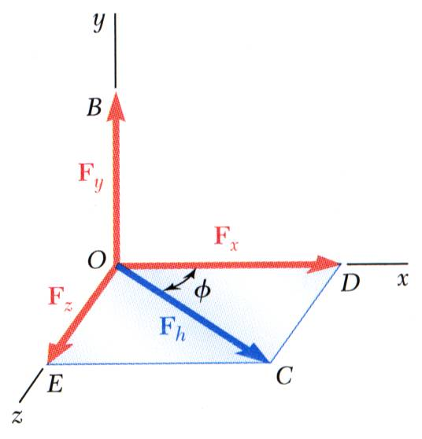
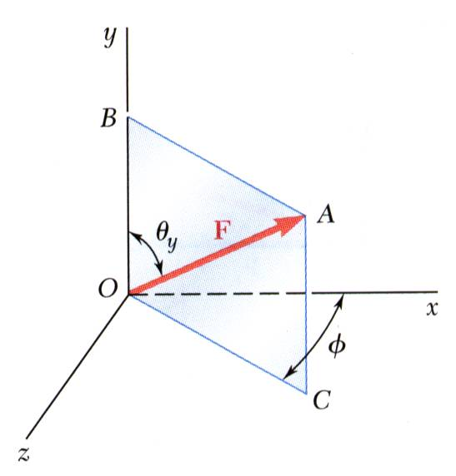
RECTANGULAR COMPONENTS IN SPACE
Resolve into horizontal and vertical components.
Resolve into rectangular components
The vector is contained in the plane OBAC.

Slide 33
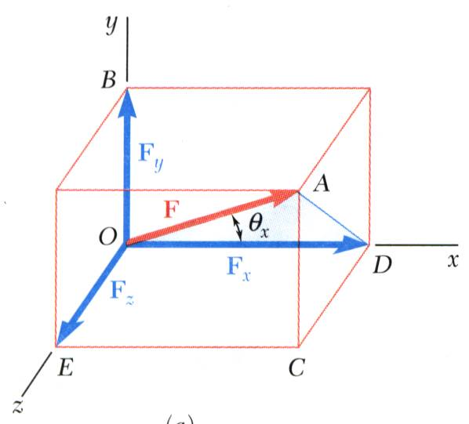



RECTANGULAR COMPONENTS IN SPACE
With the angles between and the axes,
is a unit vector along the line of action of and are the direction cosines for

Slide 34

RECTANGULAR COMPONENTS IN SPACE
Direction of the force is defined by the location of two points,

Slide 35

EXAMPLE PROBLEM 2.7
The tension in the guy wire is 2500 N. Determine:
a) components F_{x} , F_{y} , F_{z} of the force acting on the bolt at A,
b) the angles θ_{x} , θ_{y} , θ_{z} defining the direction of the force
STEPS FOR SOLUTION:
Based on the relative locations of the points A and B, determine the unit vector pointing from A towards B.
Apply the unit vector to determine the components of the force acting on A.
Noting that the components of the unit vector are the direction cosines for the vector, calculate the corresponding angles.

Slide 36
EXAMPLE PROBLEM 2.7 - SOLUTION
Determine the unit vector pointing from A towards B.
Determine the components of the force.

Slide 37
EXAMPLE PROBLEM 2.7 - SOLUTION
Noting that the components of the unit vector are the direction cosines for the vector, calculate the corresponding angles.

Slide 38


End of Chapter 2

